Slide 1
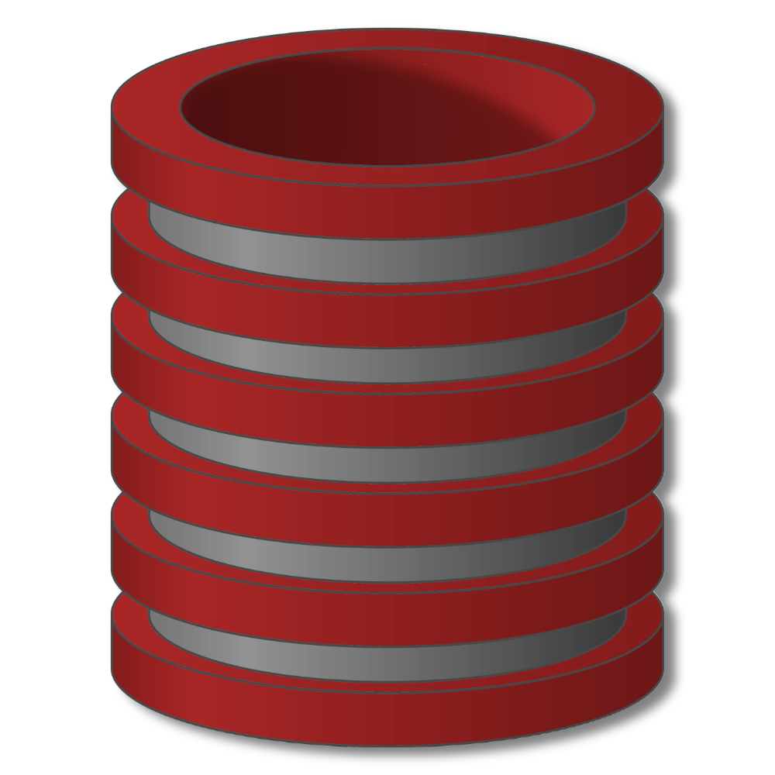
Database Systems Originally prepared by Jennifer Widom

Slide 2
Introduction to Database

Slide 3
Basics terms
Data
Information
Data base :is collection of related data that represent some real-world entities
DBMS
Database systems
Notes:
Database is collection of related data that represent some real-world entities .

Slide 4
Databases, Data, and Information
Database
Collection of data organized in a manner that allows access, retrieval, and use of that data
Data
Collection of unprocessed items
Text
Numbers
Images
Audio
Video
Information
Processed data
Documents
Audio
Images
Video
Page 514

Slide 5
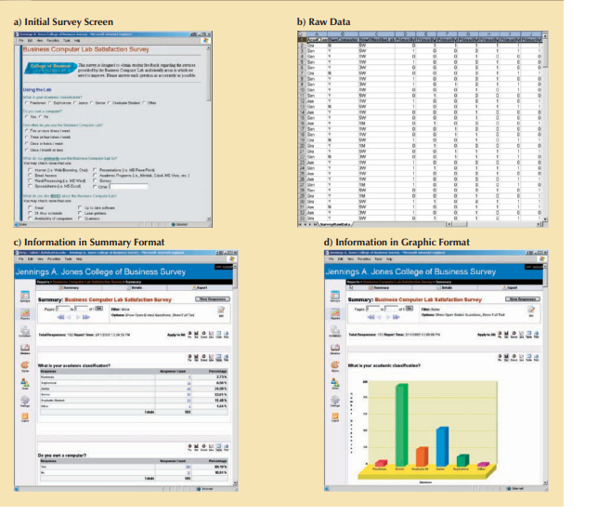
Data vs information
Notes:
Information is produced by processing data. Information is used to reveal the meaning of data.

Slide 6
File-Based Systems
Collection of application programs that perform services for the end users (e.g. reports).
Each program defines and manages its own data.

Slide 7
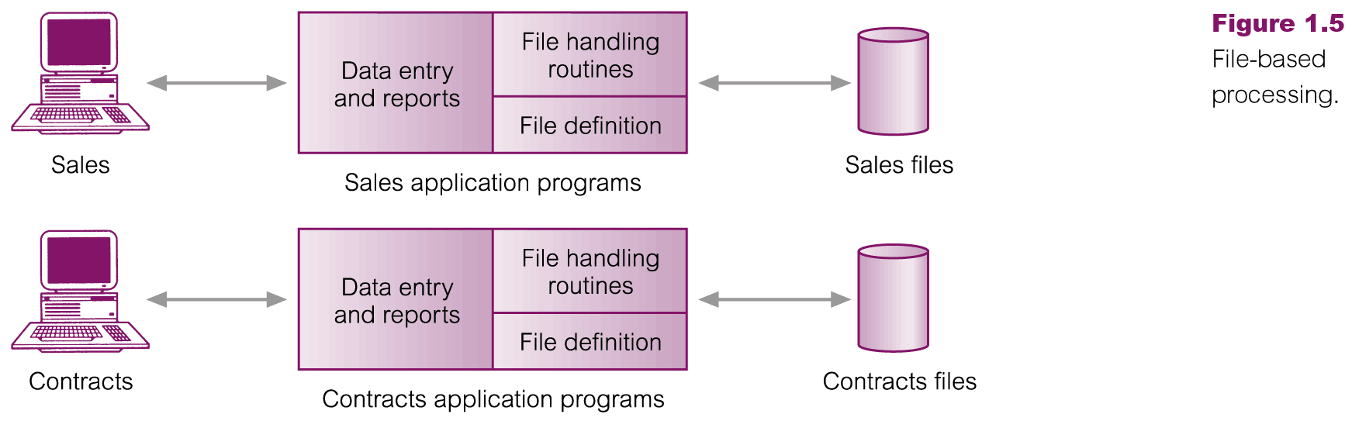
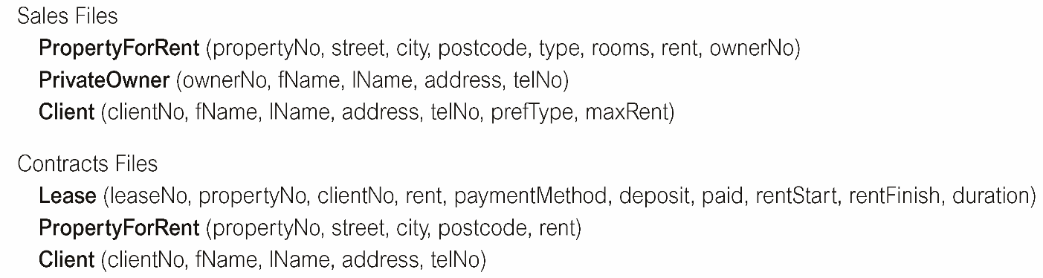
File-Based Processing

Slide 8
Limitations of File-Based Approach
Separation and isolation of data
Each program maintains its own set of data.
Users of one program may be unaware of potentially useful data held by other programs.
Duplication of data
Same data is held by different programs.
Wasted space and potentially different values and/or different formats for the same item.

Slide 9
Limitations of File-Based Approach
Data dependence
File structure is defined in the program code.
Incompatible file formats
Programs are written in different languages, and so cannot easily access each other’s files.
Fixed Queries
Programs are written to satisfy particular functions.
Any new requirement needs a new program.

Slide 10
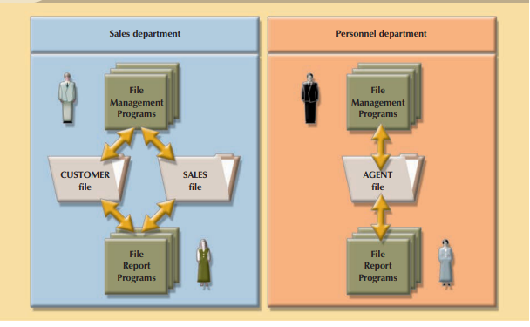
File processing system

Slide 11
Database Systems
Database Management System (DBMS) provides….
… efficient, reliable, convenient, and safe
multi-user storage of and access to massive
amounts of data.

Slide 12
DBMS
It is a collection of programs that manages the database structure and controls access to the data stored in the database.
In a sense, a database resembles a very well-organized electronic filing cabinet in which powerful software, known as a database management system, helps manage the cabinet’s contents.

Slide 13
DBMS
Database software, often called a database management system (DBMS), allows users to:
Create a computerized database
Add, modify, and delete data
Sort and retrieve data
Create forms and reports from the data
Page 515

Slide 14
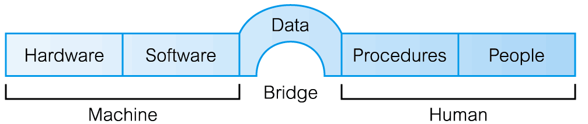
Components of DBMS Environment

Slide 15
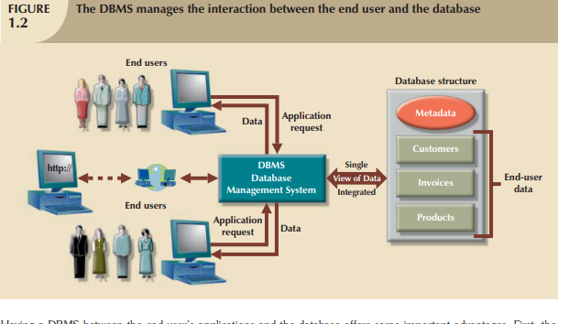
DBMS

Slide 16
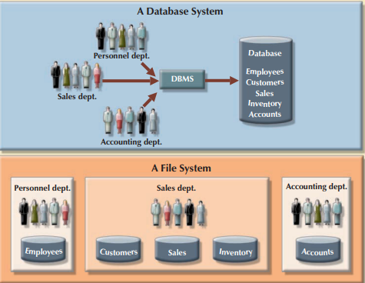
Contrasting database and file systems

Slide 17
File Processing Versus Databases
File processing system
Database approach
Each department has its own set of files
Used for many years
Have data redundancy
Isolate data
Programs and users share data
Reduce data redundancy
Improve data integrity
Share data
Allows easier access
Reduces development time
Can be more vulnerable
Pages 524 - 526

Slide 18
Maintaining Data
Validation compares data with a set of (validation checks/) rules or values to find out if the data is correct
Alphabetic/Numeric check
Range check
Consistency check (logically correct relationship)
Completeness check
(no blank fields left)
Check digit (extra digits appended to primary keys)
Other checks (eg attachment actually exists)
Pages 522 - 524

Slide 19
Databases, Data, and Information
Valuable information should have the following characteristics:
Accurate
Verifiable
Timely
Organized
Accessible
Useful
Cost-effective
Pages 516 - 517

Slide 20
Database Systems
Massive
Database systems handle data at a massive scale (Terabytes of data)
Persistent
Data in the database outlives the programs that execute on that data
Safe
Data managed by the database systems will stay in a consistent state, it won't be lost or overwritten when there are software or hardware failures.
Multi-user
Database systems allow many different users or applications to access the data concurrently
Notes:
Database systems handle data at a massive scale. So if you think about the amount of data that is being produced today, database systems are handling terabytes of data, sometimes even terabytes of data every day. And one of the critical aspects is that the data that's handled by database management systems is much larger than can fit in the memory of a typical computing system. So memories are indeed growing very, very fast, but the amount of data in the world and data to be handled by database systems is growing much faster.
Secondly, the data that's handled by database management systems is typically persistent. And what it means is that the data in the database outlives the programs that execute on that data. So if you run a typical computer program the program will start the variables we created. There will be data that's operated on the program, the program will finish and the data will go away. It's sort of the other way with databases. The data is what sits there and then program will start up, it will operate on the data, the program will stop and the data will still be there. Very often actually multiple programs will be operating on the same data.
Next, safety. So database systems, since they run critical applications such as telecommunications and banking systems, have to have guarantees that the data managed by the system will stay in a consistent state, it won't be lost or overwritten when there are failures, and there can be hardware failures. There can be software failures. Even simple power outages. You don't want your bank balance to change because the power went out at your bank branch. And of course there are the problem of malicious users that may try to corrupt data. So database systems have a number of built in mechanisms that ensure that the data remains consistent, regardless of what happens.
Database systems allow many different users or applications to access the data concurrently. So when you have multiple applications working on the same data, the system has to have some mechanisms, again, to ensure that the data stays consistent. That you don't have, for example, half of a data item overwritten by one person and the other half overwritten by another. So there's mechanisms in database systems called concurrency control. And the idea there is that we control the way multiple users access the database. Now we don't control it by only having one user have exclusive access to the database or the performance would slow down considerably. So the control actually occurs at the level of the data items in the database. So many users might be operating on the same database but be operating on different individual data items. It's a little bit similar to, say, file system concurrency or even variable concurrency in programs, except it's more centered around the data itself.

Slide 21
Database Systems
Convenient
Physical Data Independence: The way that data is actually stored and laid out on disk is independent of the way that programs/users think about the structure of the data. .
Database systems allows you to write queries in a very simple way. The system itself will find the algorithm to get that data out efficiently.
Efficient
Database systems can execute complex queries over amounts of data very efficiently
Reliable
99.99999 % up time is the type of guarantee that database management systems are making for their applications.
Notes:
The next adjective is convenience, and convenience is actually one of the critical features of database systems. They really are designed to make it easy to work with large amounts of data and to do very powerful and interesting processing on that data. So there's a couple levels at which that happens. There's a notion in databases called Physical Data Independence. It's kind of a mouthful, but what that's saying is that the way that data is actually stored and laid out on disk is independent of the way that programs think about the structure of the data. So you could have a program that operates on a database and underneath there could be a complete change in the way the data is stored, yet the program itself would not have to be changed. So the operations on the data are independent from the way the data is laid out. And somewhat related to that is the notion of high level query languages. So, the databases are usually queried by languages that are relatively compact to describe, really at a very high level what information you want from the database. Specifically, they obey a notion that's called declarative, and what declarative is saying is that in the query, you describe what you want out of the database but you don't need to describe the algorithm to get the data out, and that's a really nice feature. It allows you to write queries in a very simple way, and then the system itself will find the algorithm to get that data out efficiently.
The three most important things in a database system is first performance, second performance and again performance. So database systems have to do really thousands of queries or updates per second. These are not simple queries necessarily. These may be very complex operations. So, constructing a database system, that can execute queries, complex queries, at that rate, over gigantic amounts of data, terabytes of data is no simple task, and that is one of the major features also, provided by a database management system.
And lastly, but again not last in importance is reliability. Looking at your banking system or your telecommunications system, it's critically important that those are up all the time. So 99.99999 % up time is the type of guarantee that database management systems are making for their applications. So that gives us an idea of all the terrific things that a database system provides. I hope you're all ready convinced that if you have a application you want to build that involves data, it would be great to have all of these features provided for you in a database system.

Slide 22
Enters a DBMS
Database Systems
“Two tier database system”
connection
(ODBC, JDBC)
Database server (someone else’s C program)
Data files
Applications

Slide 23
Components of DBMS Environment
DBMS
===============
Design tools
Table Creation
Form Creation
Query Creation
Report Creation
Procedural
language
compiler (4GL)
=============
Run time
Form processor
Query processor
Report Writer
Language Run time
Database
Application
Programs
Database contains:
User’s Data
Metadata
Indexes
Application Metadata
User
Interface
Applications

Slide 24
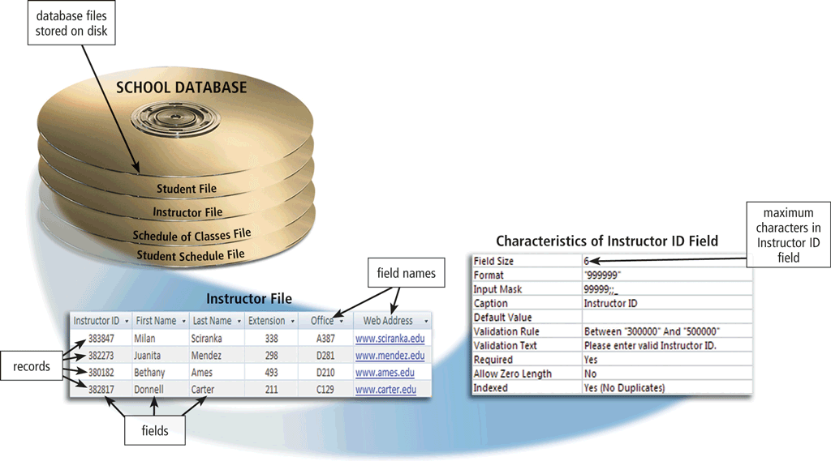
The Hierarchy of Data
Data is organized in layers
Files, records, fields, characters
Page 517
Figure 10-2

Slide 25
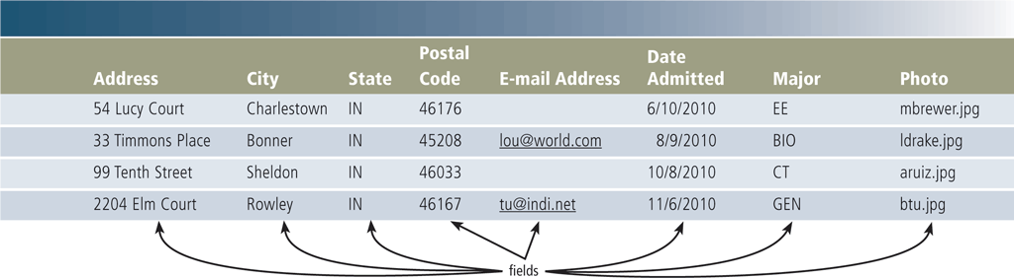
The Hierarchy of Data
A record is a group of related fields
A primary key uniquely identifies each record
A data file is a collection of related records
Page 519
Figure 10-4

Slide 26
Database Systems
Key concepts
Data model: how the data is structured. It is telling you that general form of data that's going to be stored in the database.
consists of rules and standards that define how the database organizes data
Schema versus data: logical representation
Data definition language (DDL):create ,alter ,Drop ,rename
Data manipulation or query language (DML):select ,insert ,update ,delete
Notes:
So there are four key concepts that we're going to cover for now.
The first one is the data model. The data model is a description of, in general, how the data is structured. One of the most common data models is the relational dot data model, we'll spend quite a bit of time on that. In the relational data model the data and the database is thought of as a set of records. Now another popular way to store data is for example, in XML documents, so, an XML document captures data, instead of a set of records, as a hierarchical structure, of labeled values. Another possible data model would be a graph data model or all data in the database is in the form of nodes and edges. So again, a data model is telling you the general form of data that's going to be stored in the database.
Next is the concept of schema versus data. One can think of this kind of like types and variables in a programming language. The schema sets up the structure of the database. Maybe I'm going to have information about students with IDs and GPAs, or about colleges, and it's just going to tell me the structure of the database where the data is the actual data stored within the schema. Again, in a program, you set up types and then you have variables of those types, we'll set up a schema, and then we will have a whole bunch of data that adheres to that schema. Typically the schema is set up at the beginning, and doesn't change very much where the data changes rapidly.
Now to set up the schema, one normally uses what's known as a data definition language. Sometimes people use higher level design tools that help them think about the design and then from there go to the data definition language. But it's used in general to set up a scheme or structure for a particular database.
Once the schema has been set up and data has been loaded, then it's possible to start querying and modifying the data and that's typically done with what's known as the data manipulation language, so for querying and modifying the database.

Slide 27
Database Languages
Data Definition Language (DDL)
Allows the DBA or user to describe and name entities, attributes, and relationships required for the application
plus any associated integrity and security constraints.

Slide 28
Database Languages
Data Manipulation Language (DML)
Provides basic data manipulation operations on data held in the database.
Procedural DML
allows user to tell system exactly how to manipulate data.
Non-Procedural DML
allows user to state what data is needed rather than how it is to be retrieved.

Slide 29
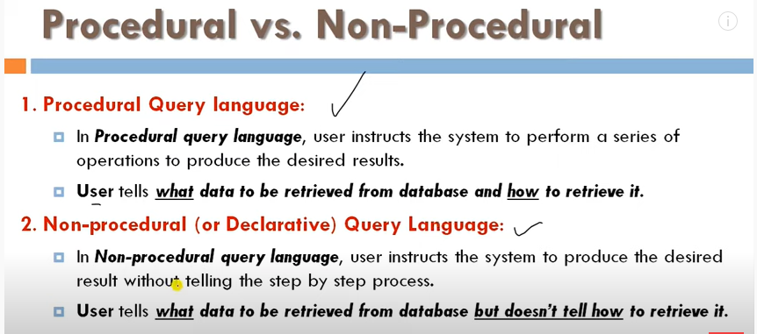

Slide 30
Database Systems
Key people
DBMS implementer
Database designer
Database application developer
Database administrator
Database Analyst
Notes:
Now let's talk about the people that are involved in a database system.
So the first person we'll mention is the person who implements the database system itself, the database implementer. That's the person who builds the system, that's not going to be the focus of this course.
The next one is the database designer. So the database designer is the person who establishes the schema for a database. So, let's suppose we have an application. We know there's going to be a lot of data involved in the application and we want to figure out how we are gonna structure that data before we build the application. That's the job of the database designer. It's a surprisingly difficult job when you have a very complex data involved in an application.
Once you've established the structure of the database then it's time to build the applications or programs that are going to run on the database, often interfacing between the eventual user and the data itself, and that's the job of the application developer, so those are the programs that operate on the database. You might, for example, have a sales database where some applications are actually inserting the sales as they happen, while others are analyzing the sales. So it's not necessary to have a one-to-one coupling between programs and databases.
And the last person is the database administrator. So the database administrator is the person who loads the data, sort of gets the whole thing running and keeps it running smoothly. So, this actually turns out to be a very important job for large database applications. For better or worse, database systems do tend to have a number of tuning parameters associated with them, and getting those tuning parameters right can make a significant difference in the all important performance of the database system. So database administrators are actually, highly valued, very important, highly paid as a matter of fact, and are, for large deployments, an important person in the entire process.
So those are the people that are involved, again, in this class we'll be focusing mostly on designing and developing applications, a little bit on administration, but in general thinking about databases and the use of database management systems from the perspective of the application builder and user.

Slide 31
Database Administration
Database analysts and administrators are responsible for managing and coordinating all database activities
Database Analyst (DA)
Decides on proper field placement, defines data relationship, and identifies users’ access privileges
Database Administrator (DBA)
Creates and maintains the data dictionary, manages security, monitors performance, and checks backup and recovery procedures
Page 538

Slide 32
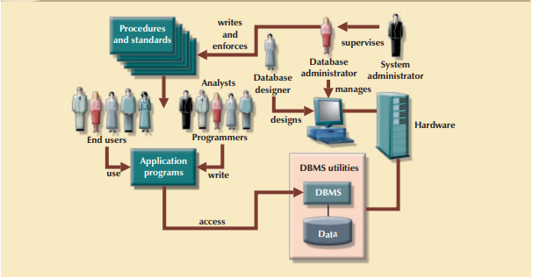
Database system environment

Slide 33
Advantages of DBMSs( self reading)
Control of data redundancy
Data consistency
More information from the same amount of data
Sharing of data
Improved data integrity
Improved security
Enforcement of standards
Economy of scale

Slide 34
Advantages of DBMSs ( self reading)
Balance conflicting requirements
Improved data accessibility and responsiveness
Increased productivity
Improved maintenance through data independence
Increased concurrency
Improved backup and recovery services

Slide 35
Disadvantages of DBMSs ( self reading)
Complexity
Size
Cost of DBMS
Additional hardware costs
Cost of conversion
Performance
Higher impact of a failure

Slide 36

Database Systems
Whether you know it or not,
you’re using a database every day

Slide 37
Examples of Database Applications
Purchases from the supermarket
Purchases using your credit card
Booking a holiday at the travel agents
Using the local library
Taking out insurance
Renting a video
Using the Internet
Studying at university

